Slide 1

Problem Statement
Mitron Bank wants to launch a new credit card but they are skeptical about launching the credit card. Hence they provided a dataset of 4000 unique customers including their spending habits in 5 cities. I as a data analyst need to analyze this data and provide them insights about the customers' needs and spending ability, this will help Mitron Bank launch the tailor-made credit card for the target customers according to their age and spending habits.

Slide 2






Home
Power BI Desktop
MITRON BANK
Credit Card Analysis
Demography
Income & Spend
Credit Card

Slide 3





MITRON BANK
Power BI Desktop
Clear all slicers
Home
Demography
Income & Spend
Credit Card
month

 | All |  | Avg Income by Gender | Avg Spend by Gender | Total Customers | Female | Male
gender
Female
Male
Male
Female
Male
Female
4000
1403
2597

73M (35.1%)
29M (32.7%)
marital status
Married
Single

134M
(64.9%)
60M
(67.3%)
Customers by marital status
Customers by Age Group & Gender
Female Male
3136
Avg Income by Marital Status
Married Single
39M (19.1%)
Avg Spend by Marital Status
Married Single 17M (19.2%)
532
25-34
966
age_group

439
All 
35-45
834
864
257
21-24
434
occupation

167M (80.9%)
72M (80.8…)
45+
175
363
All 
Married
Single
Customers by City & Occupation
Business Owners Freelancers Government Employees Salaried IT Employees Salaried Other Employees
Total Customers by City and Gender
Female Male
payment_type

All

Mumbai
Chennai Bengaluru Delhi NCR Hyderabad
185
188
100
364
241
Mumbai
Chennai Bengaluru Delhi NCR Hyderabad
385
693
115
151
92
257
219
297
537
115
191
76
226
143
255
496
113
136
67
259
169
270
474
102
118
64
188
121
196
397

Slide 4






MITRON BANK
Power BI Desktop
Clear all slicers
Home
Demography
Income & Spend
Credit Card
Total Income
1239.8M
Total Spends
531M
Average Income
207M
Average Spend
88M
Average Monthly Income
51.66K
Average Monthly Spend
22.12K
Avg Income Utilization %
42.82%
month

All 
Avg Monthly Income, Avg Monthly Spend & Avg Income Utilization % by Occupation & Month
gender
Female
Male
occupation
Average Monthly Income
Average
Monthly Spend
Average Income Utilization %
city
age_group
month


Avg Monthly Income, Avg Monthly Spend and Avg Income Utilization % by age_group
 Business Owners October May June July August September  Salaried IT Employees  Government Employees  Salaried Other Employees  Freelancers Total | 70.09K | 23.28K | 33.22%
 | 70.09K | 22.71K | 32.40%
 | 70.09K | 17.89K | 25.53%
 | 70.09K | 20.82K | 29.71%
 | 70.09K | 20.99K | 29.95%
 | 70.09K | 26.57K | 37.91%
 | 70.09K | 30.71K | 43.81%
 | 61.50K | 31.39K | 51.04%
 | 52.03K | 15.09K | 29.00%
 | 38.79K | 16.33K | 42.10%
 | 35.06K | 16.06K | 45.80%
 | 51.66K | 22.12K | 42.82%
marital status
Married
Single

Average Monthly Income Average Monthly Spend Average Income Utilization %
50%
61K
46.72%
53K
52K
age_group

43.66%
41K
All 
40%
21K
25K
23K
40.59%
17K
occupation

All 
34.70%
45+
35-45
25-34
21-24
30%
payment_type

All 

Slide 5


MITRON BANK
Power BI Desktop
Clear all slicers
Home
Demography
Income & Spend
Credit Card
Spends by Payment Type
Spends by City and Payment Type
Credit Card Debit Card Net Banking UPI
month

216M
All 
70M
gender
Female
Male

141M
46M
46M
120M
39M
40M
29M
33M
28M
25M
23M
27M
21M
marital status
Married
Single

54M
18M
18M
15M
18M
11M
11M
8M
7M
Credit Card
UPI
Debit Card
Net Banking
Mumbai
Delhi NCR
Bengaluru
Chennai
Hyderabad
age_group

All 
category

October
May June
July
August
September
Income, Spends & Average Income Utilization % by occupation
Total Income Total Spends Average Income Utilization %
 | Apparel | 5.5M | 4.4M | 5.1M | 5.2M | 6.5M | 7.4M
 | Bills
 | Credit Card | 7.5M | 5.9M | 6.9M | 7.0M | 8.8M | 10.1M
 | Debit Card | 4.1M | 3.3M | 3.8M | 3.8M | 4.8M | 5.5M
 | Net Banking | 1.8M | 1.4M | 1.6M | 1.6M | 2.1M | 2.4M
 | UPI | 3.6M | 2.9M | 3.4M | 3.4M | 4.3M | 4.9M
 | Electronics | 12.8M | 10.2M | 11.9M | 12.1M | 15.1M | 17.4M
 | Entertainment | 6.7M | 5.3M | 6.1M | 6.3M | 7.9M | 9.0M
 | Food | 7.1M | 5.7M | 6.6M | 6.7M | 8.4M | 9.6M
 | Groceries | 14.0M | 11.1M | 12.9M | 13.1M | 16.4M | 18.8M
 Health & Wellness  Others  Travel |  | 10.7M 8.4M 9.8M 10.0M 12.4M 14.4M 2.6M 2.1M 2.4M 2.4M 3.0M 3.5M 9.6M 7.6M 8.8M 9.0M 11.3M 13.0M
occupation

0.48bn
60%
All 
45.80%
51.04%
42.10%
payment_type

0.24bn
0.26bn
40%
All 
0.16bn
0.21bn
33.22%
0.09bn
0.09bn
0.12bn
0.08bn
0.04bn
20%
Salaried IT Employees
Freelancers
Salaried Other Employees
Business Owners
Government Employees

Slide 6
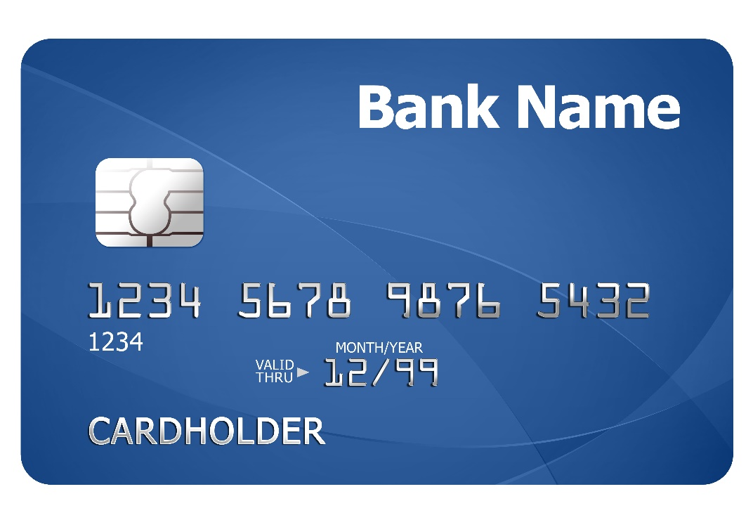
Key Insights
The three top spending areas include paying bills, buying groceries, and electronics.
Mumbai is the city where customers use the credit card the most with Delhi NCR and Bangalore are the next two big cities.
Credit card is mostly used as a payment type
Salaried IT professionals have the most Average income Utilization %, salaried other employees and freelancers come next.
25-34 and 35-45 These two age groups people have the most spending habits as their average income utilization % is more than the rest.
Married persons spend the most as compared to the single
Males are using the credit cards more than the female

Slide 7

Recommendations
For the age group of 25-34 and 35-45 credit cards with low or no annual fees are recommended as they are the most spendthrifts and the use of credit cards is more among them.
Bonus points add up and cashback are the two main features the credit must have.
As Bills, groceries and electronics are the best utilization points through credit cards cashback is required for that, and retail chains must have special promotions and discounts for the cardholders
IT Professionals and Freelancers are the two key stakeholders for credit cards so buying IT-related products should provide offers and free lounge, offers on flight tickets are some important key points to take care of.
Advance fraud detection, transaction alert messages, and customer support are the key features required a first and priority basis
Integration of UPI with credit cards is a new feature that must be added with the new credit card for easy transactions.

